Slide 1

Long Short-Term Memory (LSTM)
A Deep Dive Guide for Practitioners
A comprehensive exploration of LSTM networks — from the fundamental motivation behind their invention, through the elegant gate mechanisms that power them, to hands-on implementation and real-world clinical applications.
Arvind CS

Slide 2
OVERVIEW
Table of Contents
This guide walks you through every layer of LSTM understanding, from foundational concepts to advanced implementation details.
01
02
Foundations
LSTM Architecture
Sequential models, standard RNNs, and the vanishing gradient problem
Gate mechanisms, mathematical formulation, and the constant error carousel
03
04
Applied LSTM
Practical Guidance
ECG arrhythmia detection use case and PyTorch implementation
When to use LSTMs, their limitations, and final takeaways

Slide 3

CHAPTER 1
Introduction
In deep learning, many real-world tasks involve sequence data — data where the ordering of elements carries critical meaning. Unlike tabular datasets where each row is independent, sequential data requires models that understand temporal or positional relationships between inputs.
Standard feed-forward neural networks assume all inputs are independent and identically distributed. They have no mechanism for remembering what came before. Recurrent Neural Networks (RNNs) were introduced to address this limitation by maintaining a hidden state across time steps — but they suffer from severe training instabilities that limit their practical utility.

Slide 4




Where Sequences Are Everywhere
Sequence modeling underpins some of the most impactful applications in modern AI. Understanding these domains helps motivate why architectures like LSTM were necessary.
Natural Language
Audio & Speech
Time Series
Biomedical Signals
Sentences and paragraphs where word order determines meaning, ambiguity, and intent.
Speech signals where phonemes unfold over time and context shapes recognition accuracy.
Financial data, sensor readings, and forecasting tasks where past values predict future trends.
ECG, EEG, and other physiological signals where temporal patterns indicate health conditions.

Slide 5

CHAPTER 2
What Are Sequential Models?
Sequential models are neural network architectures specifically designed to process data where order is important, each data point depends on previous inputs, and accumulated memory of past information influences current predictions. Unlike standard classifiers that treat each sample in isolation, sequential models maintain an internal state that evolves as new inputs arrive.
The core insight is simple: to predict the next word in a sentence, you need to know what words came before. To classify a heartbeat, you need the temporal shape of the waveform. This temporal dependency is what makes sequential modeling both powerful and challenging.

Slide 6
Sequence Prediction Tasks
Sequential models power a wide range of prediction tasks across domains. Here are representative examples that illustrate the diversity of sequence-to-output mappings.
Task
Input Sequence
Output
Language Modeling
"The weather is…"
Next word prediction
ECG Classification
Electrical heart activity
Arrhythmia label
Stock Prediction
Daily closing prices
Future trend direction
Speech Recognition
Audio waveform frames
Transcribed text
Machine Translation
Source language sentence
Target language sentence
RNNs were introduced to add memory to neural networks, but they face fundamental gradient issues during training that severely limit their ability to learn from long sequences.

Slide 7
CHAPTER 3
Challenges With Standard RNNs
A basic RNN cell maintains a hidden state that is updated step-by-step as it processes each element in a sequence. The recurrence relation is deceptively simple:
Key Variables
Core Property
x_t = input at time step t
h_{t-1} = previous hidden state
h_t = current hidden state
RNNs share weights across all time steps, which enables memory flow through the hidden state. However, this weight sharing creates a compounding effect during backpropagation that becomes problematic for long sequences.

Slide 8
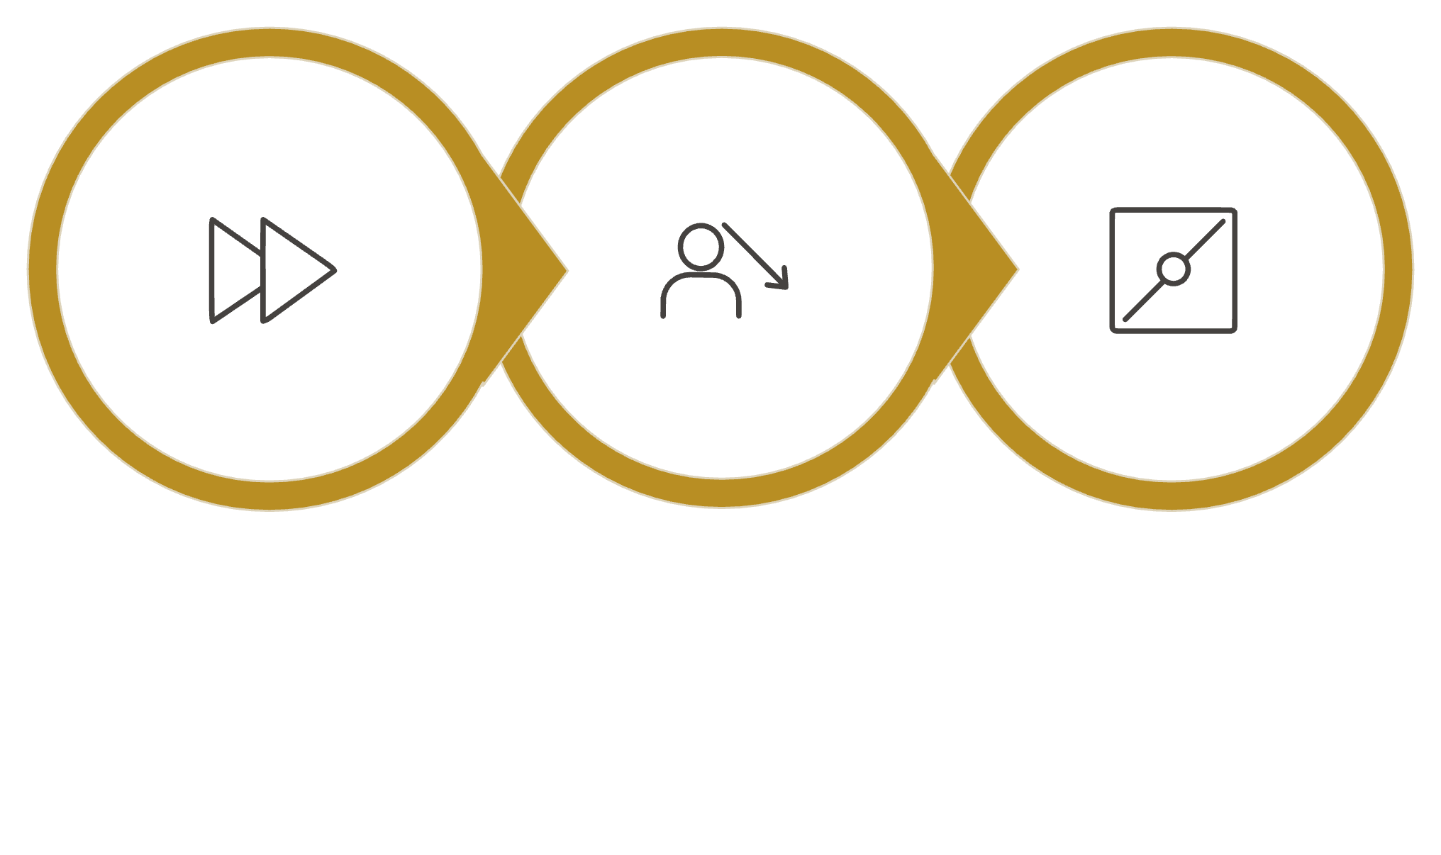

Backpropagation Through Time (BPTT)
When we train RNNs, we unroll the network across time and apply backpropagation — a process called Backpropagation Through Time (BPTT). At each step, gradients are multiplied by the recurrent weight matrix and the derivative of the activation function. Over many time steps, this repeated multiplication creates a chain of products that determines whether learning succeeds or fails.
Forward Pass
Compute Loss
Backward Pass
The critical issue is that these gradient products either shrink exponentially (vanishing) or grow exponentially (exploding), making it nearly impossible for the network to learn dependencies across more than a handful of time steps.

Slide 9


CHAPTER 4
The Vanishing & Exploding Gradient Problem
When training deep networks with backpropagation, gradients are propagated backward through many layers or time steps. The repeated multiplication of partial derivatives creates a product chain that governs learning dynamics:
Vanishing Gradients
Exploding Gradients
When partial derivatives are less than 1, the product shrinks exponentially: 0.9^{50} \approx 0.005. Earlier layers effectively stop learning.
When partial derivatives exceed 1, the product grows exponentially: 1.2^{50} \approx 9100. Weights become numerically unstable.

Slide 10
Consequences for Recurrent Networks
The vanishing gradient problem has devastating practical consequences for standard RNNs. Because gradients decay exponentially with sequence length, the network's ability to associate information across distant time steps is severely compromised.
Short-Term Bias
Lost Dependencies
Practical Failure
RNNs learn to rely almost exclusively on recent inputs, ignoring long-range context that may be essential for accurate predictions.
Relationships spanning more than 10–20 time steps are effectively invisible to the learning algorithm.
Tasks requiring long memory — like document-level language modeling or multi-beat ECG analysis — become intractable with vanilla RNNs.
"I moved to Japan 10 years ago. Now I speak fluent ___." — A vanilla RNN may forget "Japan" by the time it reaches the blank, predicting the wrong language entirely.

Slide 11
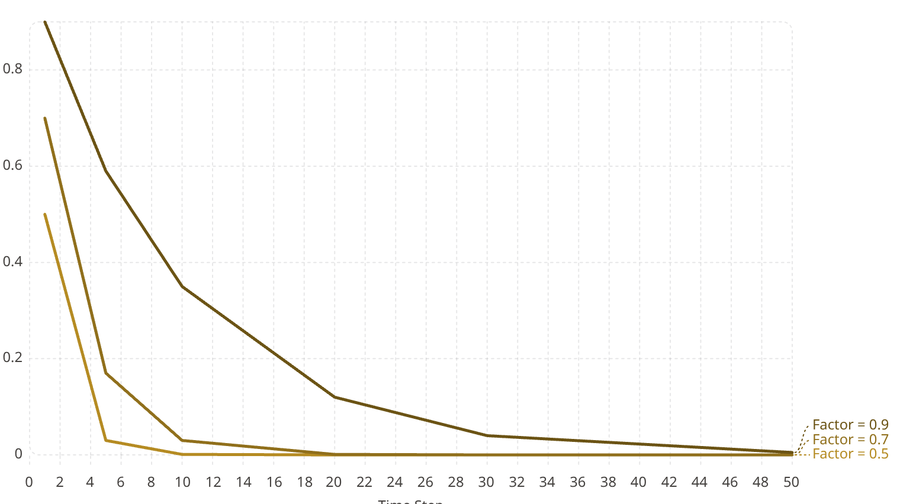
Visualizing Gradient Decay
To appreciate the severity of gradient vanishing, consider how rapidly gradient magnitude drops across time steps for typical RNN configurations. The chart below illustrates the exponential decay for three different per-step gradient multipliers.
Even with a relatively favorable per-step factor of 0.9, the gradient signal at step 50 is only 0.5% of its original magnitude — effectively zero for practical learning. This exponential decay is the fundamental reason standard RNNs fail on long sequences.

Slide 12

CHAPTER 5
Why LSTM Was Invented
In 1997, Sepp Hochreiter and Jürgen Schmidhuber published their landmark paper introducing Long Short-Term Memory networks — a specialized recurrent architecture designed to remember information across long time spans while remaining trainable via gradient-based methods.
The key insight was elegant: instead of forcing gradients to survive repeated nonlinear transformations, create a linear self-connection in the cell state that allows information (and gradients) to flow across many time steps with minimal degradation. Learnable gates then control what enters, persists in, and exits this protected memory pathway.

Slide 13



Core Design Motivations
The LSTM architecture was driven by three specific goals that directly addressed the failures of standard RNNs. Each motivation maps to a distinct architectural innovation.
Mitigate Vanishing Gradients
Maintain Long-Term Memory
Selective Information Flow
The cell state provides a constant error carousel — a pathway where gradients can flow across many time steps without exponential decay, preserving the learning signal.
Unlike the hidden state in vanilla RNNs which is overwritten at every step, the LSTM cell state can persist information indefinitely when the forget gate remains open.
Learnable gates decide when to write, erase, or read from memory — giving the network fine-grained control over what information is relevant at each time step.

Slide 14
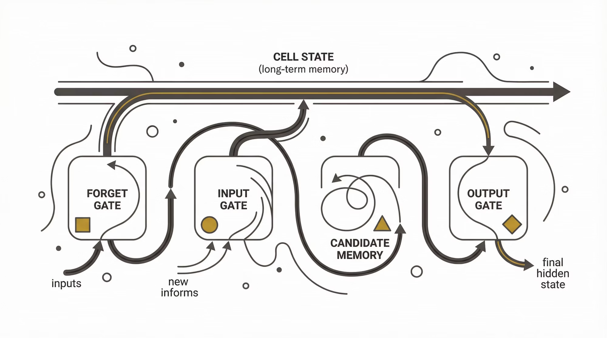

CHAPTER 6
LSTM Architecture Overview
Unlike standard RNNs that maintain only a single hidden state, the LSTM cell introduces a dual-state system: a cell state C_t that serves as long-term memory, and a hidden state h_t that serves as working memory. Three gating mechanisms regulate the flow of information between these states.

Slide 15
Core Components of LSTM
Each component of the LSTM cell serves a specific and well-defined purpose. Together, they form a system that can selectively remember, forget, and output information — capabilities that standard RNNs entirely lack.
1
2
Cell State (C)
Forget Gate
The memory highway — carries long-term information across time steps. Information can pass through unchanged unless gates explicitly modify it. This is the key innovation enabling gradient flow.
Produces a vector of values between 0 and 1 that determines what to discard from the cell state. A value of 1 means "keep entirely," while 0 means "forget completely."
3
4
Input Gate
Output Gate
Controls what new information gets written to the cell state. Works in tandem with the candidate memory to filter and store relevant updates.
Determines what portion of the cell state is exposed as the hidden state output — controlling what the rest of the network can see.

Slide 16


The Cell State: A Memory Highway
The cell state is the defining architectural innovation of LSTM. It runs along the entire sequence like a conveyor belt, carrying information from early time steps to later ones with minimal transformation.
Unlike the hidden state in vanilla RNNs — which passes through a \tanh nonlinearity at every step — the cell state is modified only through element-wise operations: multiplication by the forget gate and addition of gated new content. This linear structure is what preserves gradients during backpropagation.
Key Insight: The cell state's additive update rule (rather than multiplicative) is what prevents the exponential gradient decay that plagues standard RNNs.

Slide 17
CHAPTER 7
Gate Mechanisms Explained
LSTM gates are small neural networks with sigmoid activations that produce values between 0 and 1. These outputs act as soft switches — controlling how much information flows through each pathway. Let's examine each gate in detail.
Forget Gate
Input Gate
Output Gate
f_t = \sigma(W_f[h_{t-1}, x_t] + b_f)
i_t = \sigma(W_i[h_{t-1}, x_t] + b_i)
o_t = \sigma(W_o[h_{t-1}, x_t] + b_o)
Learns whether to keep or erase past memory based on current input and previous hidden state.
Determines which values to update in the cell state from the candidate memory.
Controls how much of the cell state's memory affects the output at this step.

Slide 18
Candidate Memory
In addition to the three gates, the LSTM computes a candidate memory vector — the potential new content that could be written to the cell state. This is computed using a \tanh activation, producing values between -1 and 1.
Why Tanh?
How It's Used
The \tanh activation bounds the candidate values to [-1, 1], providing both positive and negative updates. This allows the cell state to increase or decrease, giving the network bidirectional control over its memory content.
The candidate memory doesn't go directly into the cell state. Instead, it's filtered by the input gate — only the portions deemed relevant are actually written. This two-stage write process (candidate + gate) gives LSTM precise control over memory updates.

Slide 19
CHAPTER 8
Mathematical Formulation
With all components defined, we can now present the complete LSTM computation at each time step. Given inputs x_t (current input), h_{t-1} (previous hidden state), and C_{t-1} (previous cell state), the LSTM executes six sequential computations.
1
Forget Gate
f_t = \sigma(W_f[h_{t-1}, x_t] + b_f)
2
Input Gate
i_t = \sigma(W_i[h_{t-1}, x_t] + b_i)
3
Candidate Memory
\tilde{C}_t = \tanh(W_c[h_{t-1}, x_t] + b_c)
4
Update Cell State
C_t = f_t \cdot C_{t-1} + i_t \cdot \tilde{C}_t
5
Output Gate
o_t = \sigma(W_o[h_{t-1}, x_t] + b_o)
6
New Hidden State
h_t = o_t \cdot \tanh(C_t)

Slide 20
The Cell State Update — The Heart of LSTM
Step 4 of the LSTM computation — the cell state update — is the single most important equation in the entire architecture. It's where forgetting and remembering happen simultaneously.
First Term: Selective Forgetting
Second Term: Selective Writing
f_t \cdot C_{t-1} — The forget gate multiplies the previous cell state element-wise. Values close to 1 preserve memory; values close to 0 erase it. This gives the network learned control over what past information to retain.
i_t \cdot \tilde{C}_t — The input gate filters the candidate memory, allowing only relevant new information to be written. The additive combination (not multiplicative) is what preserves gradient flow.
Critical observation: Because the cell state update is an addition rather than a repeated multiplication, the gradient of the loss with respect to earlier cell states doesn't decay exponentially — this is the key mathematical property that solves the vanishing gradient problem.

Slide 21

CHAPTER 9
How LSTM Solves the Vanishing Gradient Problem
The cell state update rule provides the mathematical mechanism that directly addresses gradient vanishing. During backpropagation through time, the gradient of the loss with respect to the cell state at an earlier time step flows through the forget gates:
If the forget gate f_t \approx 1, the cell state remains nearly unchanged and gradients propagate without decay. The network learns to keep the forget gate open for information it needs to remember long-term, creating a stable gradient pathway across hundreds of time steps.

Slide 22
The Constant Error Carousel (CEC)
Hochreiter and Schmidhuber called this gradient-preserving mechanism the Constant Error Carousel (CEC). It's the conceptual backbone that makes LSTM fundamentally different from vanilla RNNs.
Standard RNN
Gradients must pass through \tanh and matrix multiplication at every time step. Each transformation shrinks the signal, leading to exponential decay: \prod_{k} \frac{\partial h_k}{\partial h_{k-1}} \to 0
LSTM (CEC)
Gradients flow through the cell state via element-wise multiplication by the forget gate — a learned scalar near 1. No nonlinear squashing, no matrix multiplication. Gradients propagate stably.
This mechanism doesn't just prevent vanishing gradients — it gives the network learned control over what to remember. When the forget gate learns to stay close to 1 for important features, those features persist in memory and their gradients remain strong, enabling the network to attribute credit across long temporal gaps.

Slide 23

CHAPTER 10
Use Case: ECG Arrhythmia Detection
Electrocardiogram (ECG) data is a prime example of where LSTM excels. ECG signals are time series recordings of electrical heart activity where the temporal morphology of each waveform — and the rhythm across multiple beats — carries critical diagnostic information.
A single ECG beat contains P-waves, QRS complexes, and T-waves that unfold over approximately one second. But arrhythmia detection often requires analyzing patterns across multiple consecutive beats, where long-range dependencies determine the classification. This is precisely where LSTM's ability to maintain long-term memory becomes invaluable.

Slide 24

Why LSTM for ECG?
ECG arrhythmia classification demands a model that can capture both within-beat morphology and across-beat rhythm. LSTM is uniquely suited because:
Long-Term Rhythm Patterns
Atrial fibrillation and other rhythm disorders require observing irregularity across many heartbeats — a dependency spanning hundreds of time steps.
Beat-to-Beat Correlation
Premature ventricular contractions and other beat-level anomalies are defined by how they differ from surrounding normal beats.
Waveform Continuity
The smooth temporal structure of ECG segments means that adjacent samples are highly correlated — ideal for recurrent processing.

Slide 25
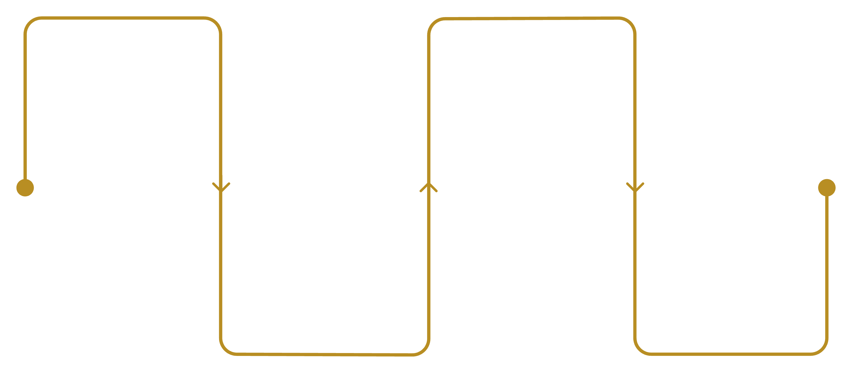
ECG-LSTM Pipeline
A typical LSTM-based arrhythmia detection system follows a straightforward pipeline from raw signal acquisition through classification. Each stage transforms the data into a form suitable for the next.
Signal
LSTM
Raw ECG acquisition
Process temporal features
Preprocess
Classify
Filtering and normalization
Softmax arrhythmia output
During preprocessing, the raw ECG signal is bandpass filtered to remove noise, segmented into fixed-length windows, and normalized. The LSTM network then processes each window sequentially, building up a temporal representation that the final dense layer and softmax classifier use to assign an arrhythmia label.

Slide 26
CHAPTER 11
LSTM in Practice: PyTorch
Implementing an LSTM in PyTorch is straightforward. Below is a minimal but functional model that demonstrates the core pattern — an LSTM encoder followed by a linear classification head. This same architecture can be adapted for ECG classification, text modeling, or any sequence task.
import torch
import torch.nn as nn
class LSTMModel(nn.Module):
def __init__(self, input_size, hidden_size,
num_layers, output_size):
super(LSTMModel, self).__init__()
self.lstm = nn.LSTM(
input_size, hidden_size,
num_layers, batch_first=True
)
self.fc = nn.Linear(hidden_size, output_size)
def forward(self, x):
out, _ = self.lstm(x)
out = self.fc(out[:, -1, :])
return out
model = LSTMModel(
input_size=10, hidden_size=64,
num_layers=2, output_size=3
)

Slide 27
Understanding the Implementation
Let's unpack the key design decisions in this PyTorch LSTM model to understand how they map to the theory we've covered.
1
2
3
Input Shape
Stacked Layers
Last Time Step
With batch_first=True, the model expects tensors of shape (batch, seq_len, features). Each sample is a sequence of 10-dimensional feature vectors — this could represent 10 ECG leads or 10 sensor channels.
num_layers=2 creates a stacked LSTM where the output of the first LSTM layer feeds into a second. This adds representational depth, allowing the network to learn hierarchical temporal features.
out[:, -1, :] extracts only the final hidden state, which encodes the entire sequence context. This is fed to the linear layer for classification into one of 3 output classes.

Slide 28
CHAPTER 12
When to Use (and Not Use) LSTM
LSTM remains a powerful tool, but modern deep learning offers many alternatives. Choosing the right architecture requires understanding where LSTM excels and where other approaches are superior.
✔ Strong Use Cases
✘ Not Ideal
Time series prediction: Forecasting, anomaly detection, sensor data
Speech recognition: Acoustic modeling with temporal context
Biomedical signals: ECG, EEG, EMG classification
Text modeling: Sequence-to-sequence tasks where data is limited
Edge deployment: Smaller model footprint vs. large Transformers
Very long sequences: Transformers with attention scale better beyond ~1K steps
Heavy parallelization needs: LSTM's sequential nature limits GPU utilization
Short sequences: 1D CNNs or simple MLPs may suffice with less overhead
Large-scale NLP: Pre-trained Transformers (BERT, GPT) dominate

Slide 29
CHAPTER 13
Limitations of LSTM
Despite its elegance, LSTM has several well-known limitations that have driven the development of newer architectures. Understanding these tradeoffs is essential for informed model selection.
Sequential Computation
Each time step depends on the previous one, making LSTMs inherently sequential. This prevents effective parallelization across the time dimension, resulting in slower training compared to Transformers on modern GPU hardware.
Memory Intensive
Storing hidden states and cell states for every time step during backpropagation requires significant memory, especially for long sequences and large hidden dimensions.
Surpassed in NLP
Transformers with self-attention have largely replaced LSTMs in natural language processing. Pre-trained models like BERT and GPT achieve superior performance with better scalability.
Hyperparameter Sensitivity
LSTMs require careful tuning of hidden size, number of layers, learning rate, and gradient clipping thresholds — the interaction between these parameters can be non-trivial to optimize.

Slide 30
FINAL SUMMARY
Key Takeaways
Long Short-Term Memory networks represent one of the most important architectural innovations in the history of deep learning. By introducing a gated memory cell with additive updates, LSTM solved the vanishing gradient problem that crippled standard RNNs and unlocked practical sequence modeling for the first time.
Memory Cell
Gated Control
Gradient Stability
Practical Impact
The cell state provides a linear pathway for long-term information storage and gradient flow.
Forget, input, and output gates give the network learned control over information flow.
The constant error carousel enables training on sequences hundreds of steps long.
From ECG analysis to speech recognition, LSTMs remain a strong baseline for sequential tasks.
Whenever sequence order matters and long-term context is essential, LSTMs are a strong starting point — and understanding their mechanisms makes you a better practitioner, even in the age of Transformers.

